Slide 1
CSC 250: Foundations of Computer Science I
Fall 2023 - Lecture 1
Amitabha Dey
Department of Computer Science
University of North Carolina at Greensboro

Slide 2
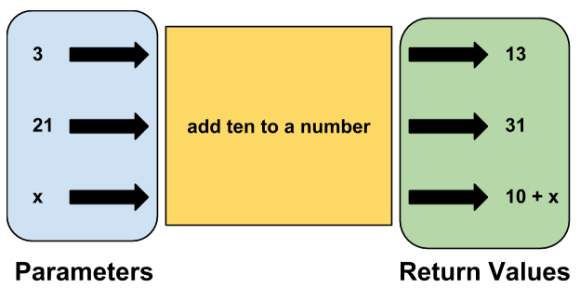
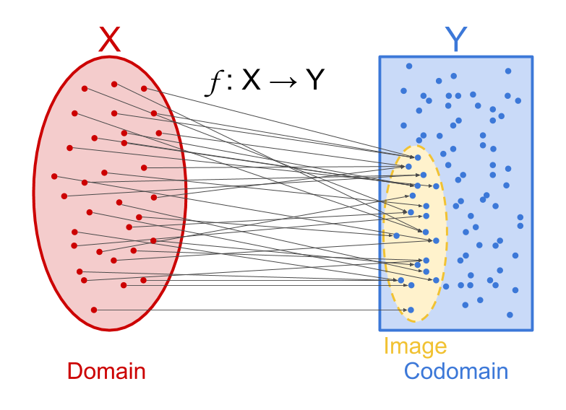
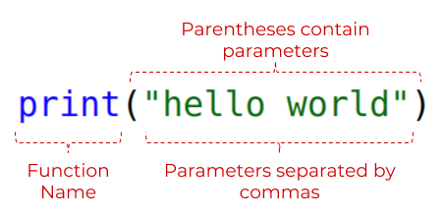
Functions
A function in math is a special relationship among
the inputs (the domain) and
their outputs (the codomain)
where each input has exactly one output, and the output can be traced back to its input.
An example of a simple function is f(x) = x².
In this function, the function f(x) takes the value of “x” and then squares it. For instance, if x = 3, then f(3) = 9.
Image credit - https://codehs.gitbooks.io/
Image credit - https://www.futurelearn.com/
Image credit - https://arbital.com/

Slide 3
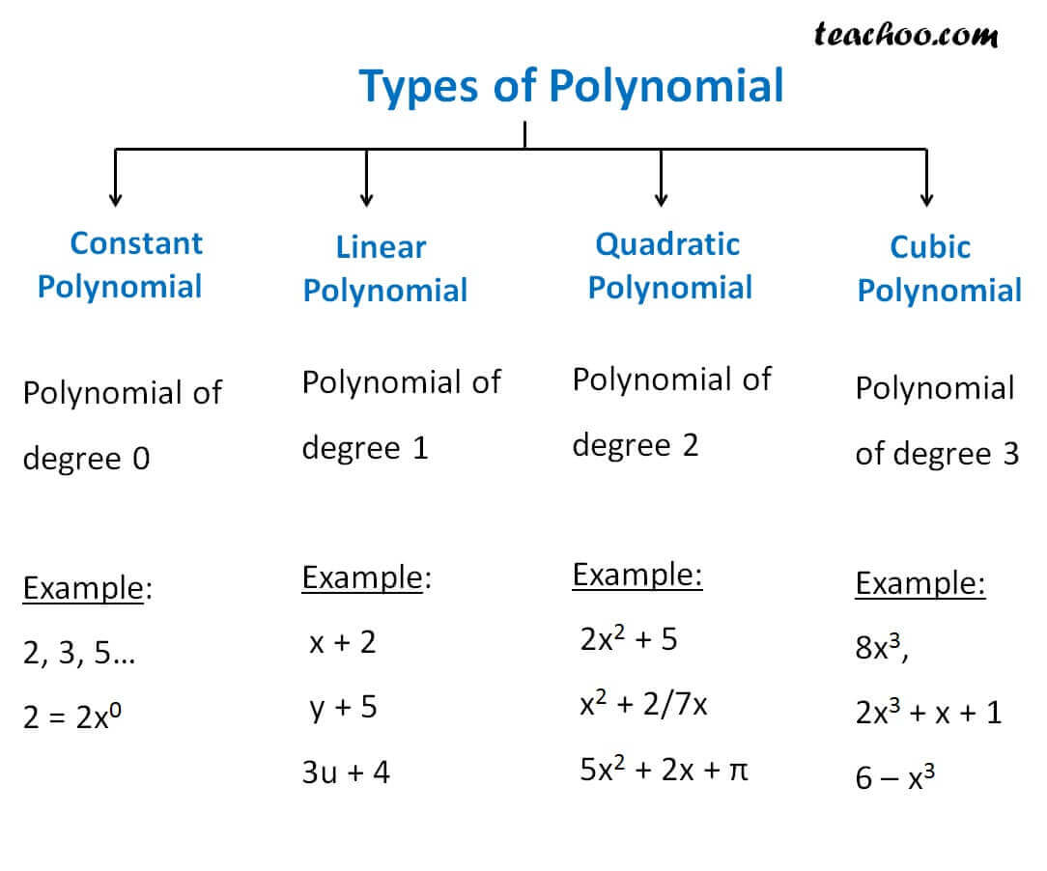
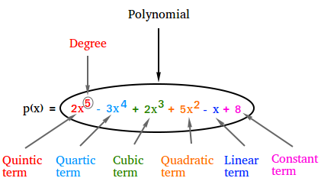
Polynomial Function
It is a function that involves only non-negative integer powers or only positive integer exponents of a variable in an equation, like the quadratic equation, cubic equation, etc.
For example, 2x+5 is a polynomial that has exponent equal to 1. A quadratic function is a second-degree polynomial function. A cubic function is a polynomial function of degree 3.
Image credit - https://www.teachoo.com/
Image credit - https://www.basic-mathematics.com/

Slide 4
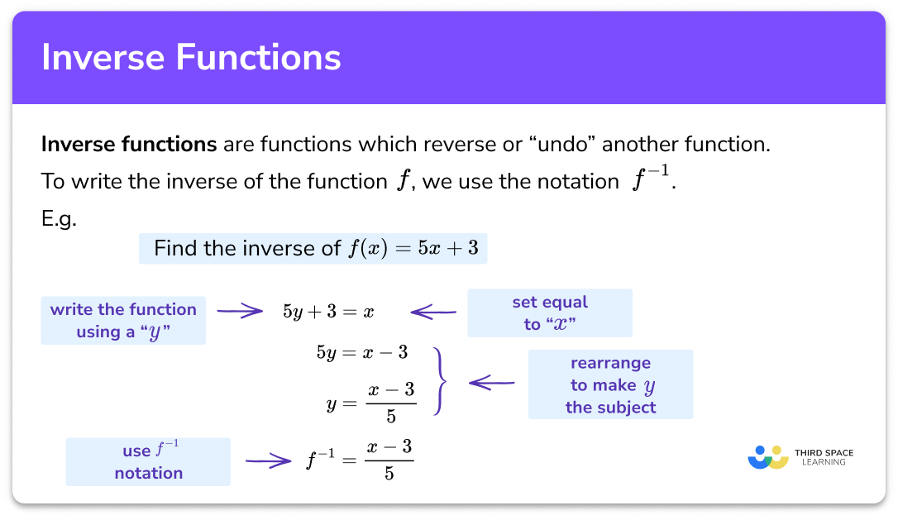
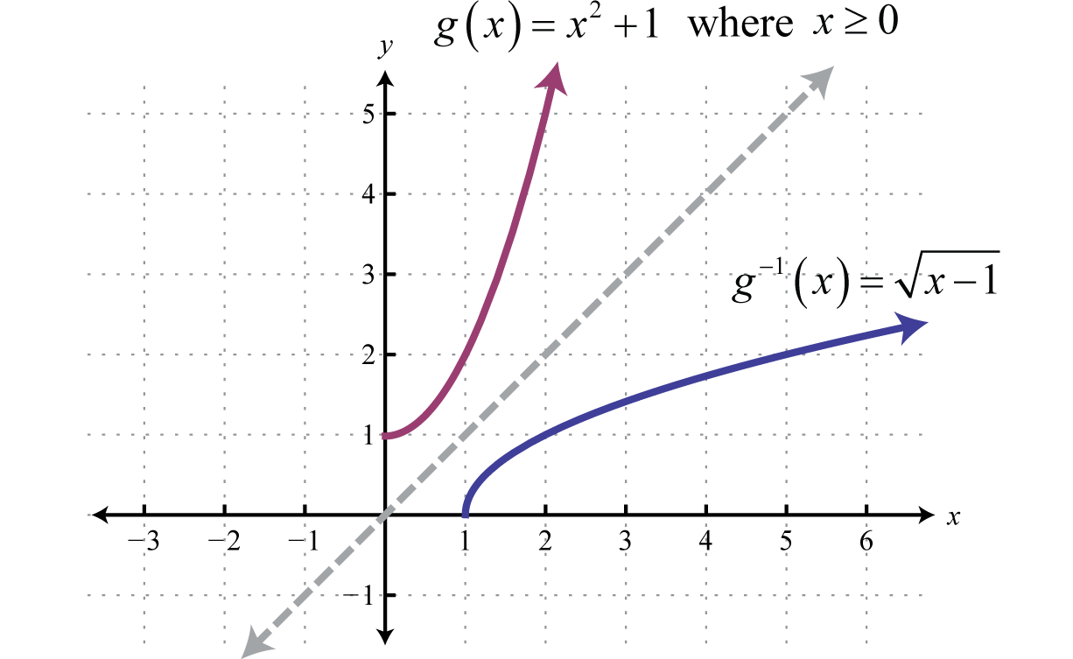
Inverse Function
It reverse the action of a function. If a function takes a to b, then the inverse function must take b to a. Imagine if you could open a door but could never close it. The inverse captures this idea of reversibility. In a cryptographic hash, a property is that there exists no inverse of a function to keep our data secure.
Image credit - https://thirdspacelearning.com/
Image credit - https://saylordotorg.github.io/

Slide 5
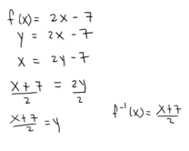
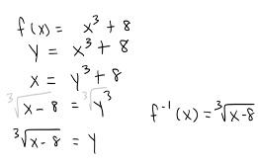
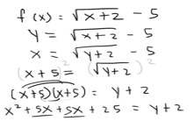
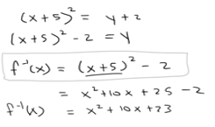
Inverse Function
Image credit - The Organic Chemistry Tutor

Slide 6
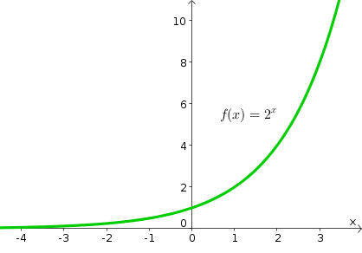
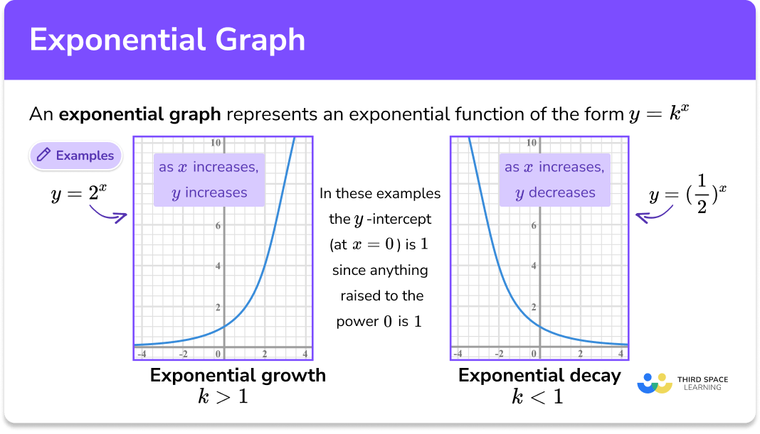
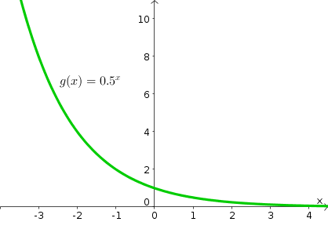
Exponential Function
To form an exponential function, we let the independent variable be the exponent. Exponential functions are solutions to the simplest types of dynamical systems.
Exponential growth is often mentioned in the context of computing: we’ve seen exponential improvements in computer storage (Moore’s law); kilobytes of memory in a computer used to be a big deal, but now gigabytes are the norm; a 1GB flash drive used to be huge, then 2GB was the standard, then 4GB, and so on.
Growth in the size of the computing industry has also seen exponential phenomena; the value of a company can go through the roof, the number of people subscribing to a social media site can explode.
Image credit - https://thirdspacelearning.com/
Image credit - https://mathinsight.org/

Slide 7
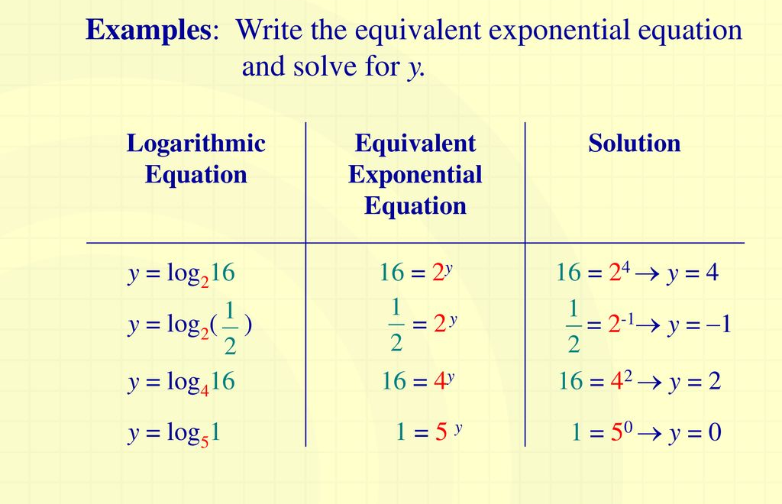
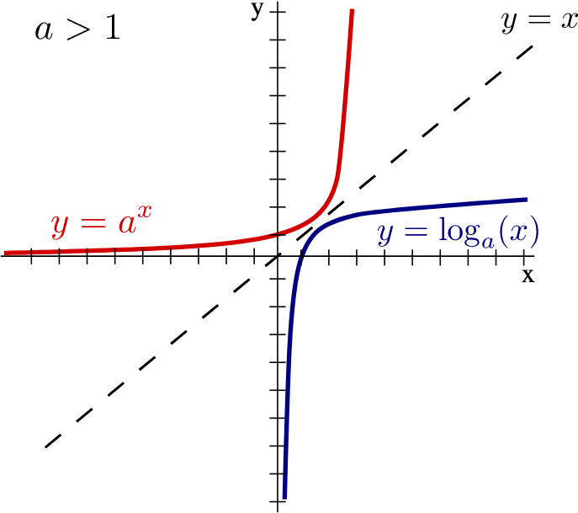
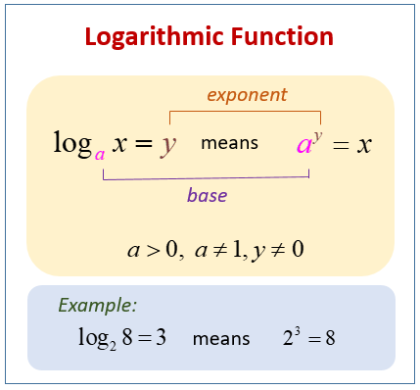
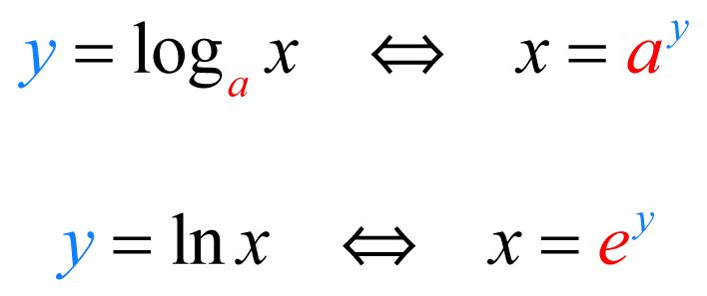
Logarithmic Function
Logarithmic functions are the inverses of exponential functions, and any exponential function can be expressed in logarithmic form.
How many times must one “base” number be multiplied by itself to get some other particular number or (what power you have to raise to, to get another number) or we can also define it as The power (or exponent) to which one base number must be raised (multiplied by itself) to produce another number.
Image credit - https://www.onlinemathlearning.com/
Image credit - https://www.sfu.ca/
Image credit - https://www.onlinemathlearning.com/
Image credit - https://calcworkshop.com/

Slide 8
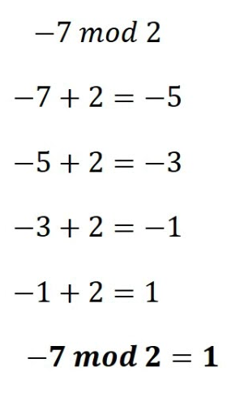
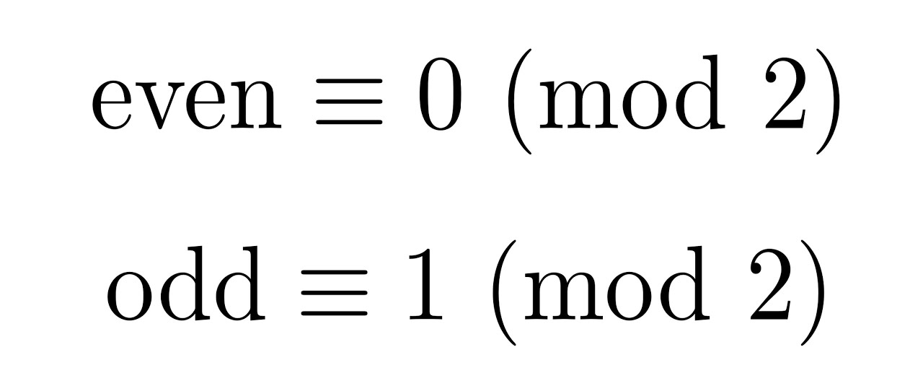
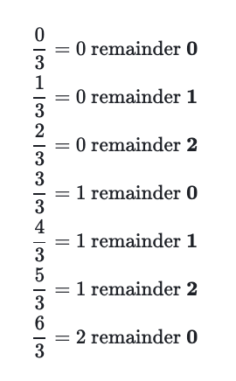
Mod Function
Returns the remainder after number is divided by divisor (The number by which you want to divide number). modulo operation returns the remainder or signed remainder of a division, after one number is divided by another (called the modulus of the operation).
1 mod 5 = 1
2 mod 5 = 2
4 mod 5 = 4
5 mod 5 = 0
6 mod 5 = 1
7 mod 5 = 2
Image credit - Mu Prime Math
Image credit - https://www.khanacademy.org/
Image credit - Maths Center

Slide 9
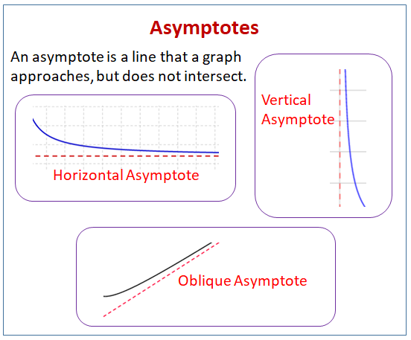
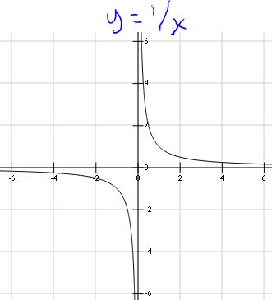
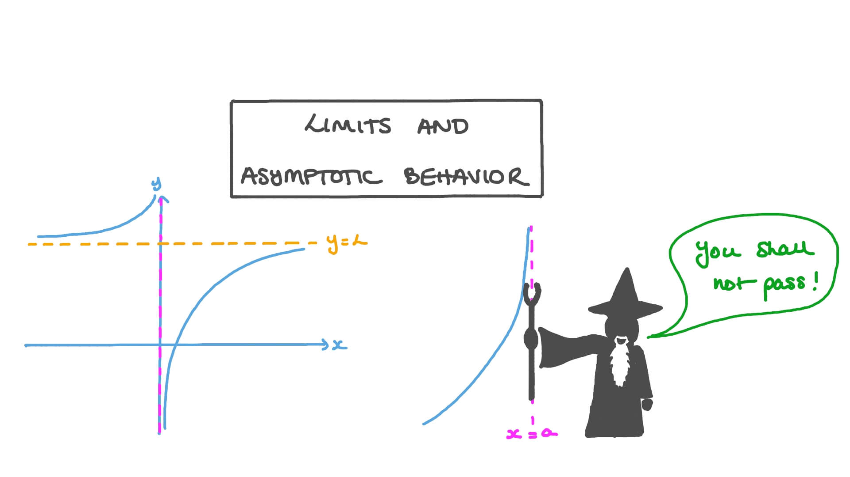
Asymptotic Function
In analytic geometry (study of geometry using a coordinate system), an asymptote of a curve is a line such that the distance between the curve and the line approaches zero as one or both of the x or y coordinates tends to infinity.
Image credit - https://www.onlinemathlearning.com/
Image credit - https://study.com/
Image credit - https://www.nagwa.com/

Slide 10
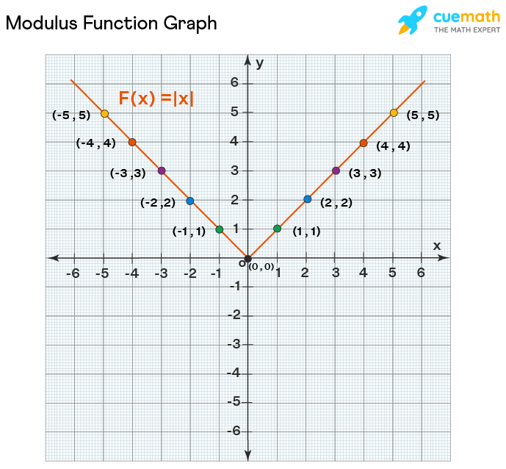
Modulus Function
A modulus function gives the magnitude of a number irrespective of its sign. It is also called the absolute value function.
In mathematics, the modulus of a real number x is given by the modulus function, denoted by |x|. It gives the non-negative value of x. The modulus or absolute value of a number is also considered as the distance of the number from the origin or zero.
A modulus function is a function which gives the absolute value of a number or variable. It produces the magnitude of the number of variables. It is also termed as an absolute value function. The outcome of this function is always positive, no matter what input has been given to the function. It is represented as y = |x|.
Image credit - https://www.onlinemathlearning.com/

